Slide 1
Minimum Edit Distance
Definition of Minimum Edit Distance

Slide 2
How similar are two strings?
Spell correction
  The user typed “graffe”
  Which is closest?
    graf
    graft
    grail
    giraffe
Computational Biology
  Align two sequences of nucleotides
  Resulting alignment:
AGGCTATCACCTGACCTCCAGGCCGATGCCC
TAGCTATCACGACCGCGGTCGATTTGCCCGAC
-AGGCTATCACCTGACCTCCAGGCCGA--TGCCC---
TAG-CTATCAC--GACCGC--GGTCGATTTGCCCGAC
Also for Machine Translation, Information Extraction, Speech Recognition

Slide 3
Edit Distance
The minimum edit distance between two strings
Is the minimum number of editing operations
  Insertion
  Deletion
  Substitution
Needed to transform one into the other

Slide 4

Minimum Edit Distance
Two strings and their alignment:

Slide 5
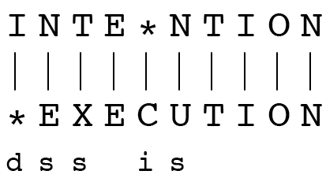
Minimum Edit Distance
If each operation has cost of 1
  Distance between these is 5
If substitutions cost 2 (Levenshtein)
  Distance between them is 8

Slide 6
Alignment in Computational Biology
Given a sequence of bases
An alignment:
Given two sequences, align each letter to a letter or gap
AGGCTATCACCTGACCTCCAGGCCGATGCCC
TAGCTATCACGACCGCGGTCGATTTGCCCGAC
-AGGCTATCACCTGACCTCCAGGCCGA--TGCCC---
TAG-CTATCAC--GACCGC--GGTCGATTTGCCCGAC

Slide 7
Other uses of Edit Distance in NLP
Evaluating Machine Translation and speech recognition
R Spokesman confirms senior government adviser was shot
H Spokesman said the senior adviser was shot dead
S I D I
Named Entity Extraction and Entity Coreference
  IBM Inc. announced today
  IBM profits
  Stanford President John Hennessy announced yesterday
  for Stanford University President John Hennessy

Slide 8
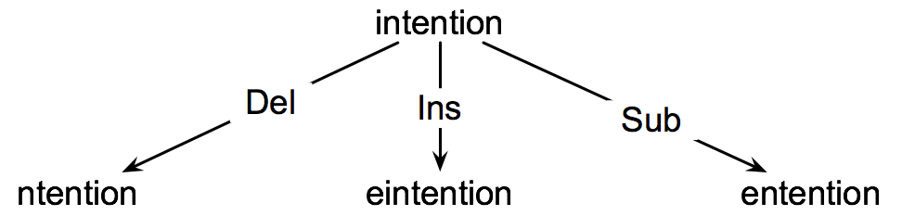
How to find the Min Edit Distance?
Searching for a path (sequence of edits) from the start string to the final string:
  Initial state: the word we’re transforming
  Operators: insert, delete, substitute
  Goal state: the word we’re trying to get to
  Path cost: what we want to minimize: the number of edits

Slide 9
Minimum Edit as Search
But the space of all edit sequences is huge!
  We can’t afford to navigate naïvely
  Lots of distinct paths wind up at the same state.
    We don’t have to keep track of all of them
    Just the shortest path to each of those revisted states.

Slide 10
Defining Min Edit Distance
For two strings
  X of length n
  Y of length m
We define D(i,j)
  the edit distance between X[1..i] and Y[1..j]
    i.e., the first i characters of X and the first j characters of Y
  The edit distance between X and Y is thus D(n,m)

Slide 11
Minimum Edit Distance
Computing Minimum Edit Distance

Slide 12
Dynamic Programming for
Minimum Edit Distance
Dynamic programming: A tabular computation of D(n,m)
Solving problems by combining solutions to subproblems.
Bottom-up
  We compute D(i,j) for small i,j
  And compute larger D(i,j) based on previously computed smaller values
  i.e., compute D(i,j) for all i (0 < i < n) and j (0 < j < m)

Slide 13
Defining Min Edit Distance (Levenshtein)
Initialization
  D(i,0) = i
  D(0,j) = j
Recurrence Relation:
  For each i = 1…M
  For each j = 1…N
  D(i-1,j) + 1
  D(i,j)= min D(i,j-1) + 1
  D(i-1,j-1) + 2; if X(i) ≠ Y(j)
  0; if X(i) = Y(j)
Termination:
  D(N,M) is distance

Slide 14
The Edit Distance Table
N | 9
O | 8
I | 7
T | 6
N | 5
E | 4
T | 3
N | 2
I | 1
# | 0 | 1 | 2 | 3 | 4 | 5 | 6 | 7 | 8 | 9
 | # | E | X | E | C | U | T | I | O | N

Slide 15
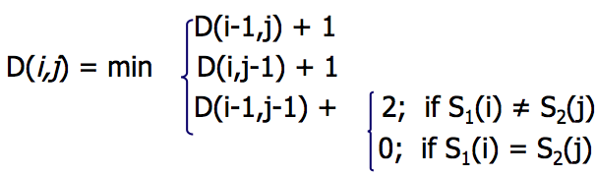
The Edit Distance Table
N | 9
O | 8
I | 7
T | 6
N | 5
E | 4
T | 3
N | 2
I | 1
# | 0 | 1 | 2 | 3 | 4 | 5 | 6 | 7 | 8 | 9
 | # | E | X | E | C | U | T | I | O | N

Slide 16
Edit Distance
N | 9
O | 8
I | 7
T | 6
N | 5
E | 4
T | 3
N | 2
I | 1
# | 0 | 1 | 2 | 3 | 4 | 5 | 6 | 7 | 8 | 9
 | # | E | X | E | C | U | T | I | O | N

Slide 17
The Edit Distance Table
N | 9 | 8 | 9 | 10 | 11 | 12 | 11 | 10 | 9 | 8
O | 8 | 7 | 8 | 9 | 10 | 11 | 10 | 9 | 8 | 9
I | 7 | 6 | 7 | 8 | 9 | 10 | 9 | 8 | 9 | 10
T | 6 | 5 | 6 | 7 | 8 | 9 | 8 | 9 | 10 | 11
N | 5 | 4 | 5 | 6 | 7 | 8 | 9 | 10 | 11 | 10
E | 4 | 3 | 4 | 5 | 6 | 7 | 8 | 9 | 10 | 9
T | 3 | 4 | 5 | 6 | 7 | 8 | 7 | 8 | 9 | 8
N | 2 | 3 | 4 | 5 | 6 | 7 | 8 | 7 | 8 | 7
I | 1 | 2 | 3 | 4 | 5 | 6 | 7 | 6 | 7 | 8
# | 0 | 1 | 2 | 3 | 4 | 5 | 6 | 7 | 8 | 9
 | # | E | X | E | C | U | T | I | O | N

Slide 18
Minimum Edit Distance
Computing Minimum Edit Distance

Slide 19
Minimum Edit Distance
Backtrace for Computing Alignments

Slide 20
Computing alignments
Edit distance isn’t sufficient
  We often need to align each character of the two strings to each other
We do this by keeping a “backtrace”
Every time we enter a cell, remember where we came from
When we reach the end,
  Trace back the path from the upper right corner to read off the alignment

Slide 21
Edit Distance
N | 9
O | 8
I | 7
T | 6
N | 5
E | 4
T | 3
N | 2
I | 1
# | 0 | 1 | 2 | 3 | 4 | 5 | 6 | 7 | 8 | 9
 | # | E | X | E | C | U | T | I | O | N

Slide 22
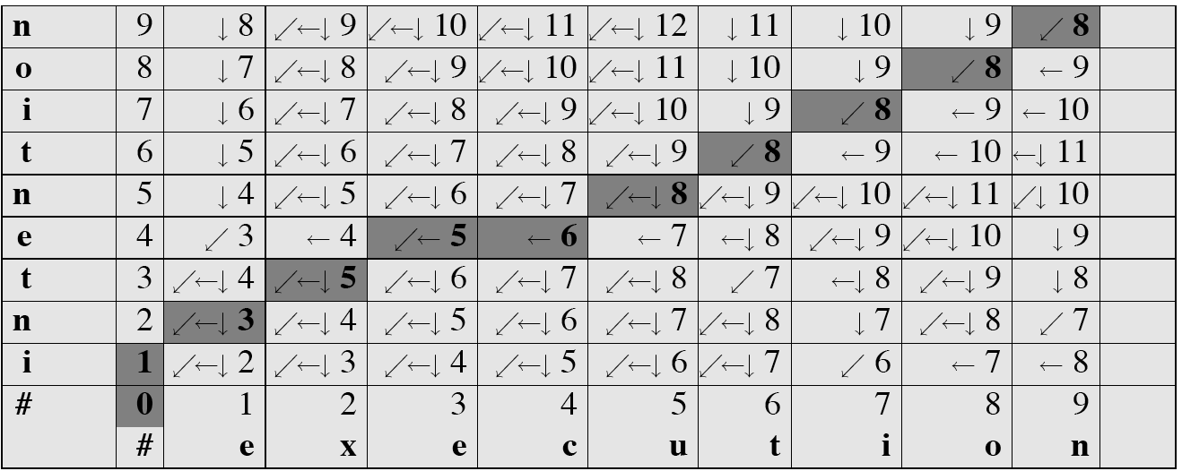
MinEdit with Backtrace

Slide 23
Adding Backtrace to Minimum Edit Distance
Base conditions: Termination:
  D(i,0) = i D(0,j) = j D(N,M) is distance
Recurrence Relation:
  For each i = 1…M
  For each j = 1…N
  D(i-1,j) + 1
  D(i,j)= min D(i,j-1) + 1
  D(i-1,j-1) + 2; if X(i) ≠ Y(j)
  0; if X(i) = Y(j)
  LEFT
  ptr(i,j)= DOWN
  DIAG
deletion
insertion
substitution
insertion
deletion
substitution

Slide 24
Minimum Edit Distance
Minimum Edit Distance in Computational Biology

Slide 25
Sequence Alignment
AGGCTATCACCTGACCTCCAGGCCGATGCCC
TAGCTATCACGACCGCGGTCGATTTGCCCGAC
-AGGCTATCACCTGACCTCCAGGCCGA--TGCCC---
TAG-CTATCAC--GACCGC--GGTCGATTTGCCCGAC

Slide 26
Why sequence alignment?
Comparing genes or regions from different species
  to find important regions
  determine function
  uncover evolutionary forces
Assembling fragments to sequence DNA
Compare individuals to looking for mutations

Slide 27
Alignments in two fields
In Natural Language Processing
  We generally talk about distance (minimized)
    And weights
In Computational Biology
  We generally talk about similarity (maximized)
    And scores

Slide 28
Longest Common Subsequence
x=ABCBDAB and
y=BDCABA,
BCA is a common subsequence and
BCBA and BDAB are two LCSs
Notes:
Change Management
http://www.ahrq.gov/professionals/education/curriculum-tools/teamstepps/longtermcare/module8/igltcchangemgmt.pptx

Slide 29
N- grams Methods
Subdivide words into N-grams -set of overlapping substrings of length N
N=2:
(radio) ⇒ (ra - ad - di -io)
N=3:
(radio) ⇒ (rad - adi - dio)
Notes:
Change Management
http://www.ahrq.gov/professionals/education/curriculum-tools/teamstepps/longtermcare/module8/igltcchangemgmt.pptx

Slide 30
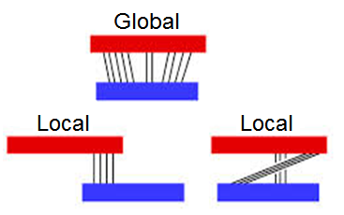
Global / Local Alignment

Slide 31
Approaches to Pairwise Sequence Alignment
Dot Matrix.
Dynamic Programming.
  Simpler approach.
  Visual Alignment
  Two sequences to be matched are lined as
axes on a grid.
  Rows – characters in first sequence
  Columns – chars in 2nd sequence
Notes:
Change Management
http://www.ahrq.gov/professionals/education/curriculum-tools/teamstepps/longtermcare/module8/igltcchangemgmt.pptx

Slide 32
Procedure
A dot is placed wherever there is an exact match.
Any region of similarity is revealed by a row of dots.
It can be easy to visually identify certain sequence features such as insertions, deletions,repeats.
Notes:
Change Management
http://www.ahrq.gov/professionals/education/curriculum-tools/teamstepps/longtermcare/module8/igltcchangemgmt.pptx

Slide 33
Dot Plots
Seq A: CTTAACT SeqB：CGGATCAT
C G G A T C A T
C
T
T
A
A
C
T
Notes:
Change Management
http://www.ahrq.gov/professionals/education/curriculum-tools/teamstepps/longtermcare/module8/igltcchangemgmt.pptx

Slide 34
Dynamic Programming
Solve a problem by taking solutions for subparts of the problem.
Store sub-problem solutions for further use
in the problem
Avoid recalculating the scores already considered.
  Needleman-Wunch Algorithm
  Smith-Waterman Algorithm
Notes:
Change Management
http://www.ahrq.gov/professionals/education/curriculum-tools/teamstepps/longtermcare/module8/igltcchangemgmt.pptx

Slide 35
Needleman Wunch Algorithm
Setting up DP Matrix
 | - | G | A | A | T | T | C | A | G | T | T | A
-
G
G
A
T
C
G
A
Notes:
Change Management
http://www.ahrq.gov/professionals/education/curriculum-tools/teamstepps/longtermcare/module8/igltcchangemgmt.pptx

Slide 36
Global Alignment
Scoring Scheme
S(a_{i}b_{i}): match/mismatch score
W: gap penalty score
S(a_{i}b_{i})= +5 match score
S(a_{i}b_{i})= -3 mismatch
score
W=-4 gap penalty
Notes:
Change Management
http://www.ahrq.gov/professionals/education/curriculum-tools/teamstepps/longtermcare/module8/igltcchangemgmt.pptx

Slide 37
Steps for DP
Three steps:
Initialization
Matrix Fill(scoring)
Traceback (alignment)
Notes:
Change Management
http://www.ahrq.gov/professionals/education/curriculum-tools/teamstepps/longtermcare/module8/igltcchangemgmt.pptx

Slide 38
Initialization Step
Each row S_{i,0} is set to w* i
Each Col S_{0,j} set to w* i
 | - | G | A | A | T | T | C | A | G | T | T | A
- | 0 | -4 | -8 | -12 | -16 | -20 | -24 | -28 | -32 | -36 | -40 | -44
G | -4
G | -8
A | -12
T | -16
C | -20
G | -24
A | -28
Notes:
Change Management
http://www.ahrq.gov/professionals/education/curriculum-tools/teamstepps/longtermcare/module8/igltcchangemgmt.pptx

Slide 39
Matrix Fill Step
S_{i,j} = Maximum [
S_{i-1, j-1} + s(a_{i,}b_{j}) match/mismatch in diagonal), S_{i,j-1} + w (gap in sequence #1),
S_{i-1,j} + w (gap in sequence #2)]
 | - | G | A | A | T | T | C | A | G | T | T | A
- | 0 | -4 | -8 | -12 | -16 | -20 | -24 | -28 | -32 | -36 | -40 | -44
G | -4 | 5
G | -8
A | -12
T | -16
C | -20
G | -24
A | -28
Notes:
Change Management
http://www.ahrq.gov/professionals/education/curriculum-tools/teamstepps/longtermcare/module8/igltcchangemgmt.pptx

Slide 40
Matrix Fill Step – 2nd Cell
 | - | G | A | A | T | T | C | A | G | T | T | A
- | 0 | -4 | -8 | -12 | -16 | -20 | -24 | -28 | -32 | -36 | -40 | -44
G | -4 | 5 | 1
G | -8
A | -12
T | -16
C | -20
G | -24
A | -28
Notes:
Change Management
http://www.ahrq.gov/professionals/education/curriculum-tools/teamstepps/longtermcare/module8/igltcchangemgmt.pptx

Slide 41
Completion of First Row
 | - | G | A | A | T | T | C | A | G | T | T | A
- | 0 | -4 | -8 | -12 | -16 | -20 | -24 | -28 | -32 | -36 | -40 | -44
G | -4 | 5 | 1 | -3 | -7 | -11 | -15 | -19 | -23 | -27 | -31 | -35
G | -8
A | -12
T | -16
C | -20
G | -24
A | -28
Notes:
Change Management
http://www.ahrq.gov/professionals/education/curriculum-tools/teamstepps/longtermcare/module8/igltcchangemgmt.pptx

Slide 42
Matrix Fill
 | - | G | A | A | T | T | C | A | G | T | T | A
- | 0 | -4 | -8 | -12 | -16 | -20 | -24 | -28 | -32 | -36 | -40 | -44
G | -4 | 5 | 1 | -3 | -7 | -11 | -15 | -19 | -23 | -27 | -31 | -35
G | -8 | 1
A | -12
T | -16
C | -20
G | -24
A | -28
Notes:
Change Management
http://www.ahrq.gov/professionals/education/curriculum-tools/teamstepps/longtermcare/module8/igltcchangemgmt.pptx

Slide 43
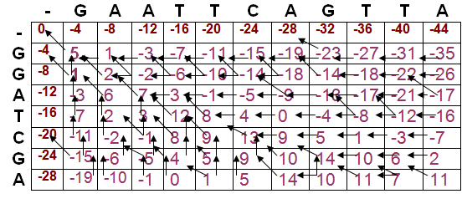
Filled Matrix
Notes:
Change Management
http://www.ahrq.gov/professionals/education/curriculum-tools/teamstepps/longtermcare/module8/igltcchangemgmt.pptx

Slide 44
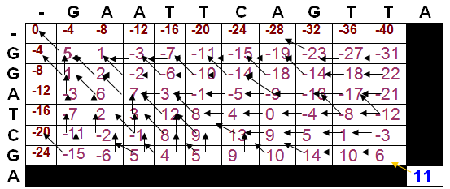
Traceback
Actual alignment for maximum score begins in postion S_{m,n}
Notes:
Change Management
http://www.ahrq.gov/professionals/education/curriculum-tools/teamstepps/longtermcare/module8/igltcchangemgmt.pptx

Slide 45
Traceback
 | - | G | A | A | T | T | C | A | G | T | T | A
- | 0 | -4 | -8 | -12 | -16 | -20 | -24 | -28 | -32 | -36 | -40 | -44
G | -4 | 5 | 1 | -3 | -7 | -11 | -15 | -19 | -23 | -27 | -31 | -35
G |  |  | 2 | -2 | -6 | -10 | -14 | -18 | -14 | -18 | -22 | -26
A | -12 | -3 | 6 | 7 | 3 | -1 | -5 | -9 | -13 | -17 | -21 | -17
T | -16 | -7 | 2 | 3 | 12 | 8 | 4 | 0 | -4 | -8 | -12 | -16
C | -20 | -11 | -2 | -1 | 8 | 9 | 13 | 9 | 5 | 1 | -3 | -7
G | -24 | -15 | -6 | 5 | 4 | 5 | 9 | 10 | 14 | 10 | 6 | 2
A | -28 | -19 | -10 | -1 | 0 | 1 | 5 | 14 | 10 | 11 | 7 | 11
G A A T T C A G T T A
| | | | | |
G G A – T C – G - - A
Notes:
Change Management
http://www.ahrq.gov/professionals/education/curriculum-tools/teamstepps/longtermcare/module8/igltcchangemgmt.pptx

Slide 46
Verification
The resulting global alignment is as follows:
G A A T T C A G T T A
| | | | | |
G G A – T C – G - — A
+ - + - + + - + - - +
5 3 5 4 5 5 4 5 4 4 5
5 – 3 + 5 – 4 + 5 + 5 – 4 + 5 – 4 –4 + 5 = 11
Notes:
Change Management
http://www.ahrq.gov/professionals/education/curriculum-tools/teamstepps/longtermcare/module8/igltcchangemgmt.pptx

Slide 47
Local Alignment
Negative scores for mismatches
When the dynamic programming scoring matrix value becomes negative, the value is set
to zero, which has the effect of terminating any alignment up to that point.
Notes:
Change Management
http://www.ahrq.gov/professionals/education/curriculum-tools/teamstepps/longtermcare/module8/igltcchangemgmt.pptx

Slide 48
Matrix Fill Score
S_{i,j} = Maximum [S_{i-1, j-1} + s(a_{i,}b_{j}) match/mismatch in diag),
S_{i,j-1} + w (gap in sequence #1),
S_{i-1,j} + w (gap in sequence #2)],
0]
The local alignments are then produced by starting at the highest-scoring positions in the scoring matrix and following a trace path from those positions up to a box that scores zero.
Notes:
Change Management
http://www.ahrq.gov/professionals/education/curriculum-tools/teamstepps/longtermcare/module8/igltcchangemgmt.pptx

Slide 49
Initialization
 | - | G | A | A | T | T | C | A | G | T | T | A
- | 0 | 0 | 0 | 0 | 0 | 0 | 0 | 0 | 0 | 0 | 0 | 0
G | 0
G | 0
A | 0
T | 0
C | 0
G | 0
A | 0
Notes:
Change Management
http://www.ahrq.gov/professionals/education/curriculum-tools/teamstepps/longtermcare/module8/igltcchangemgmt.pptx

Slide 50
Matrix Fill Step
 | - | G | A | A | T | T | C | A | G | T | T | A
- | 0 | 0 | 0 | 0 | 0 | 0 | 0 | 0 | 0 | 0 | 0 | 0
G | 0 | 5
G | 0
A | 0
T | 0
C | 0
G | 0
A | 0
Notes:
Change Management
http://www.ahrq.gov/professionals/education/curriculum-tools/teamstepps/longtermcare/module8/igltcchangemgmt.pptx

Slide 51
Matrix Fill Step
 | - | G | A | A | T | T | C | A | G | T | T | A
- | 0 | 0 | 0 | 0 | 0 | 0 | 0 | 0 | 0 | 0 | 0 | 0
G | 0 | 5 | 1
G | 0
A | 0
T | 0
C | 0
G | 0
A | 0
Notes:
Change Management
http://www.ahrq.gov/professionals/education/curriculum-tools/teamstepps/longtermcare/module8/igltcchangemgmt.pptx

Slide 52
Completing the Remaining Cells
 | - | G | A | A | T | T | C | A | G | T | T | A
- | 0 | 0 | 0 | 0 | 0 | 0 | 0 | 0 | 0 | 0 | 0 | 0
G | 0 | 5 | 1 | 0
G | 0
A | 0
T | 0
C | 0
G | 0
A | 0
Notes:
Change Management
http://www.ahrq.gov/professionals/education/curriculum-tools/teamstepps/longtermcare/module8/igltcchangemgmt.pptx

Slide 53
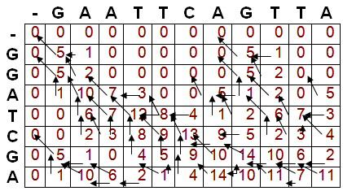
Filled Matrix
Notes:
Change Management
http://www.ahrq.gov/professionals/education/curriculum-tools/teamstepps/longtermcare/module8/igltcchangemgmt.pptx

Slide 54
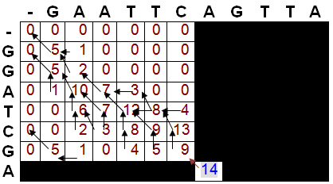
Traceback
Notes:
Change Management
http://www.ahrq.gov/professionals/education/curriculum-tools/teamstepps/longtermcare/module8/igltcchangemgmt.pptx

Slide 55
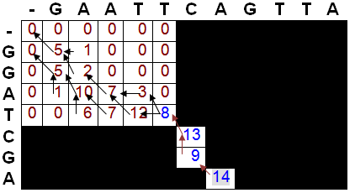
Traceback
C - A
| |
C G A
Notes:
Change Management
http://www.ahrq.gov/professionals/education/curriculum-tools/teamstepps/longtermcare/module8/igltcchangemgmt.pptx

Slide 56
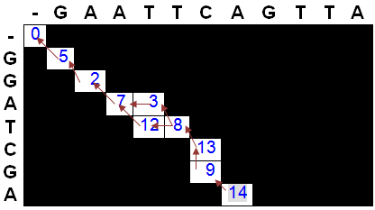
Traceback
Notes:
Change Management
http://www.ahrq.gov/professionals/education/curriculum-tools/teamstepps/longtermcare/module8/igltcchangemgmt.pptx

Slide 57
Verification
G A A T T C - A
| | | | |
G G A T – C G A
+ - + + - + - +
5 3 5 5 4 5 4 5
G A A T T C - A
| | | | |
G G A – T C G A
+ - + - + + - +
5 3 5 4 5 5 4 5
Notes:
Change Management
http://www.ahrq.gov/professionals/education/curriculum-tools/teamstepps/longtermcare/module8/igltcchangemgmt.pptx

